Slide 1

DF Coaching
A web application for coaching and scorecard process automation

Slide 2
Table of Contents
Overview
Scope & Limitation
Components
Login
Admin Control Panel
Dashboard
Sessions
History
Feedback form

Slide 3
Overview
This web application mainly focused on automating the existing process of coaching in the Digital Fulfillment department, making it a paperless process. The web application can also help leaders to organize their team and also help agents to monitor their status based on the available data.

Slide 4
Scope
Limitations
Accurately display scorecard item and its actual score depending on the agent’s role
Add/modify existing scorecard item details for every roles
Display team data of leaders
Display the current score standing of agents
Manage the sessions per week
Highly dependent on Excel file when displaying score data
Excel file must be reformat as (*.xlsx) file and convert all formulas to values
Excel file containing score data must be updated daily to reflect the data displayed for the users
Cannot dynamically add another type of session (Scorecard, Coaching, Triad, etc..)

Slide 5

Components Login
Let the user access their account by confirming their credentials
The landing page of the web application

Slide 6
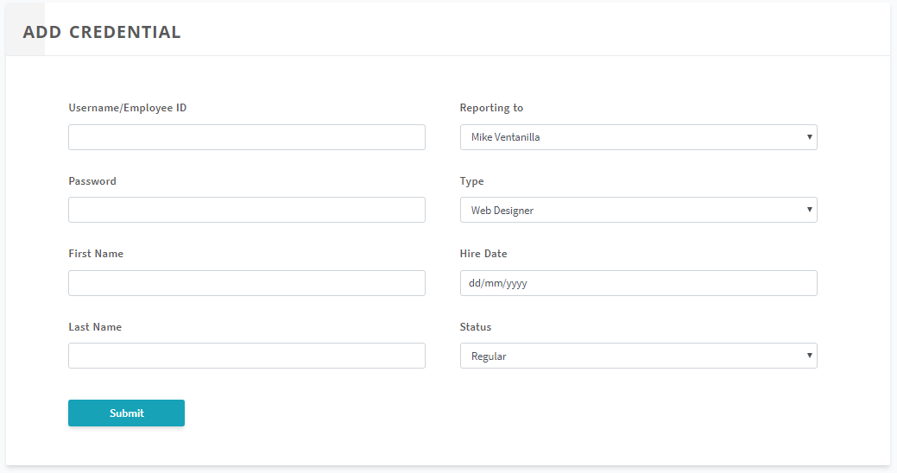
Components Admin Control Panel Add Credential
Let the administrator add new credential into the web application
All fields are required
Hire date helps the application determine the proficiency of the user

Slide 7
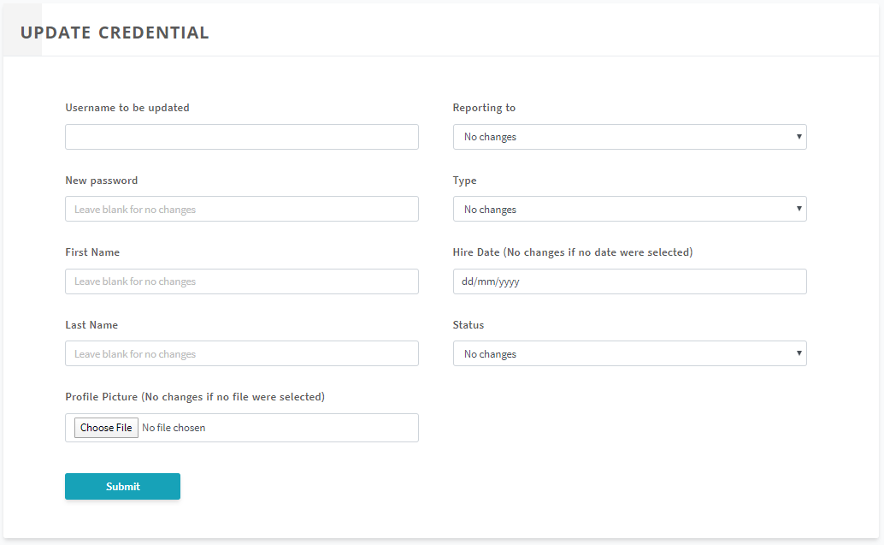
Components Admin Control Panel Update Credential
Let the administrator modify current credential into the web application
Username to be updated is the only required field
Hire date helps the application determine the proficiency of the user

Slide 8
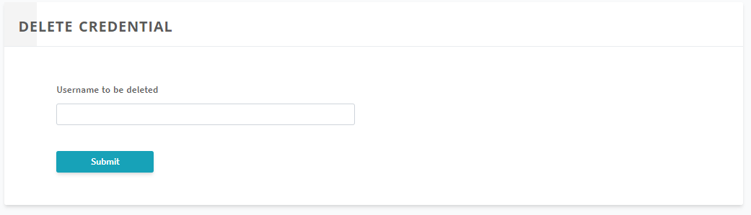
Components Admin Control Panel Delete Credential
Let the administrator delete current credential into the web application

Slide 9
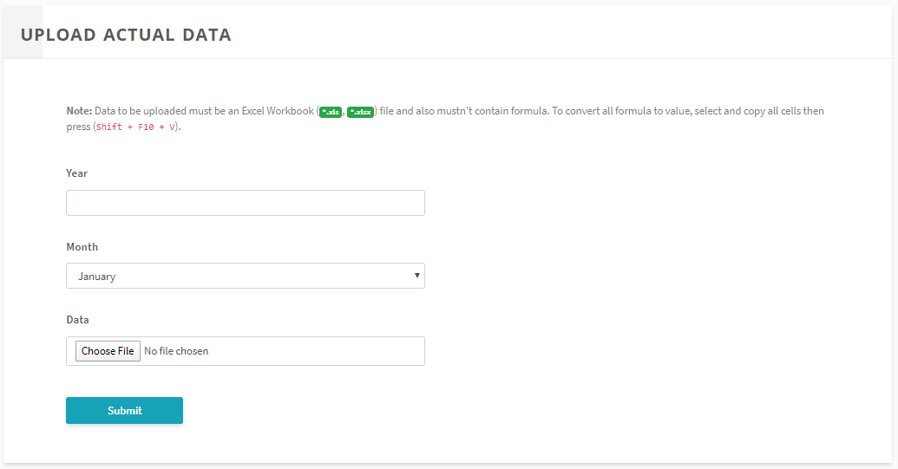
Components Admin Control Panel Upload Data
Let the administrator upload actual data to be read throughout the web application
Data field accepts only (*.xlsx) files
Excel file must be free of formula. To convert all formula to value, select all the cells on a worksheet then copy all, then press Shift + F10 + V.
The current extension of the Excel file provided was (*.xlsb) which is not supported and must be resaved as (*.xlsx)
Actual data is always displayed as the official data on all types of dashboard

Slide 10
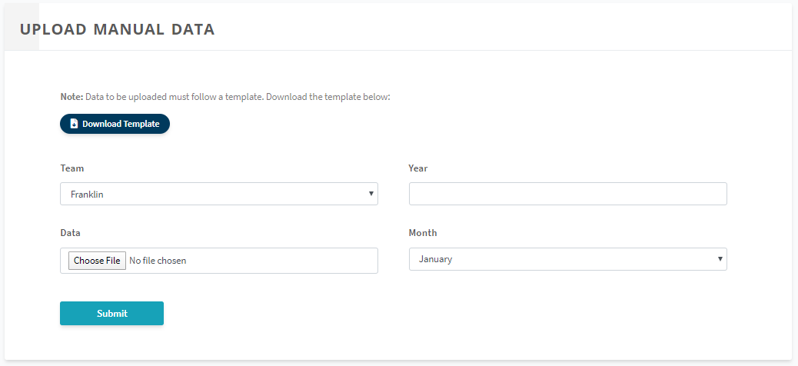
Components Admin Control Panel Upload Manual Data
Let the administrator upload manual data to be read in any scorecard session in manual mode
Data field accepts only (*.xlsx) files
Excel file follow the template we provided by clicking the ‘Download Template button’
The administrator must also specify which team does this data belong to
Manual data is never displayed as the official data on all types of dashboard

Slide 11
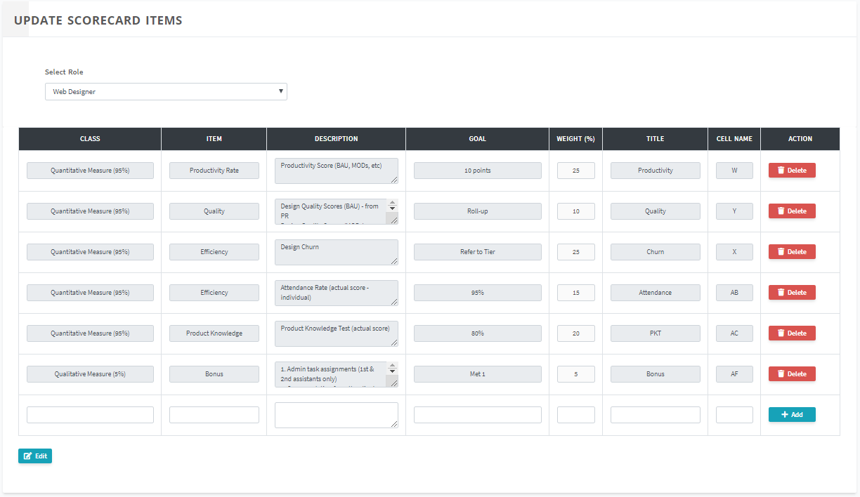
Components Admin Control Panel Update Scorecard Items
Let the administrator add/update/delete the current scorecard items on each roles
Title column is the definitive title for the scores displayed on dashboards
Cell Name column helps the web application to locate the actual score in the worksheet of an actual excel file by specifying the underlying cell name of the scorecard item inside the worksheet

Slide 12
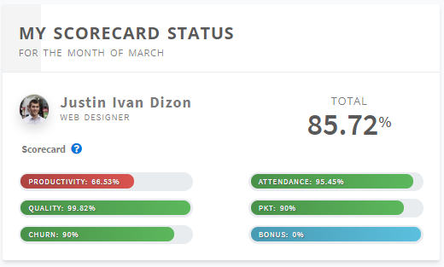
Components Dashboard My Scorecard Status
Displays the current scorecard summary of the agent based on the actual data
(Available only for agents)

Slide 13
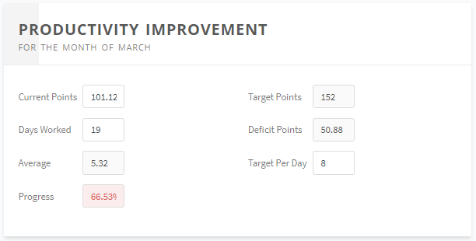
Components Dashboard Productivity Improvement
Let you simulate your productivity score
Agents can adjust the fields Current Points, Days Worked and Target Per Day
(Available only for agents)

Slide 14
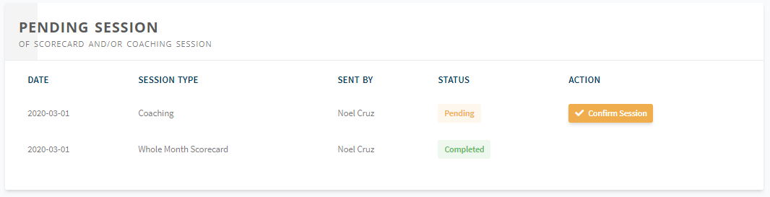
Components Dashboard User Sessions
Let the user access their pending sessions and view its details and current status
(Available to all roles with different component titles)
Titles
Agent: Pending Session
Supervisor: My Summary
OM & OH: Supervisors Summary

Slide 15
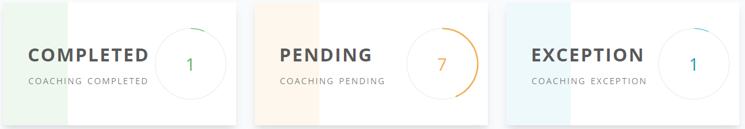
Components Dashboard Counter Cards
Let the user see the current count of completed sessions, pending sessions and excepted agents this week
(Available only to leaders)

Slide 16
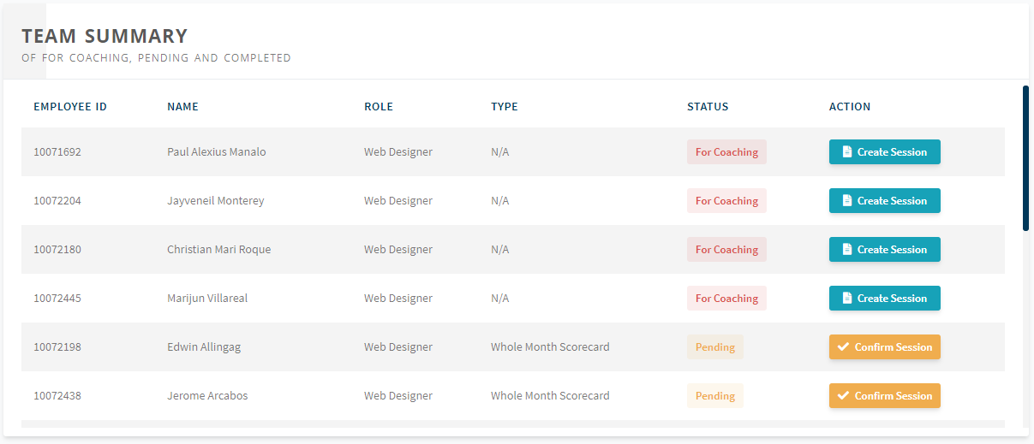
Components Dashboard Team Sessions
Let the user access team-level pending sessions and view its details and current status
(Available only to leaders with different component titles)
Titles
Supervisor: Team Summary
OM & OH: Teams Summary

Slide 17
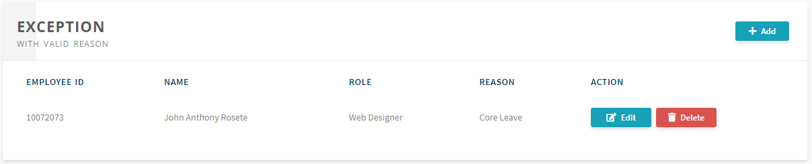
Components Dashboard Exceptions
Let the user view the agents who are excepted and their reason
(Available only to leaders, only supervisors can except their agents)

Slide 18
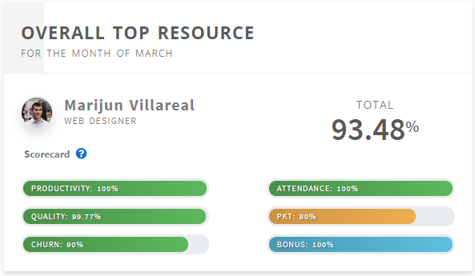
Components Dashboard Overall Top Resource
Let the user view the current overall top agent on his/her team
(Available only to supervisors)

Slide 19
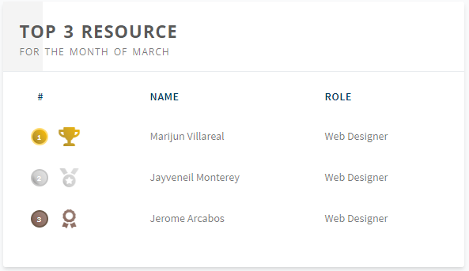
Components Dashboard Top 3 Resource
Let the user view the current top three agent ranking on his/her team
(Available only to supervisors)

Slide 20
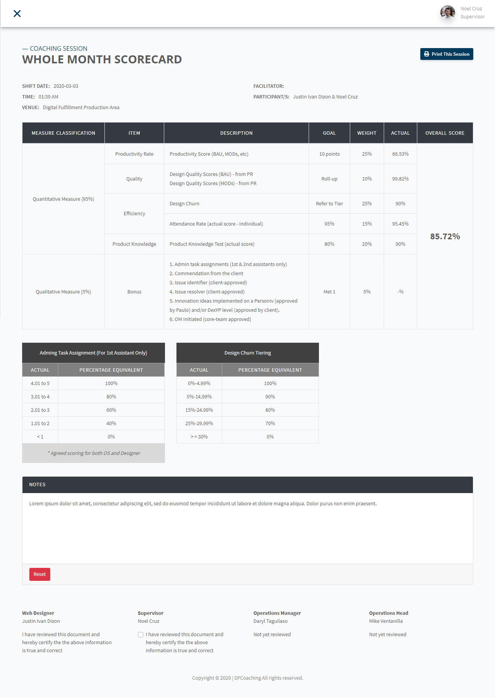
Components Sessions Scorecard
Let the user view the mid-month or whole month scorecard details of selected agent
Scorecard table can dynamically change its format depending on the role of the agent
Has Notes field and four signatures to be signed by ticking the checkbox then verifying the signee’s password
(For agents only)

Slide 21
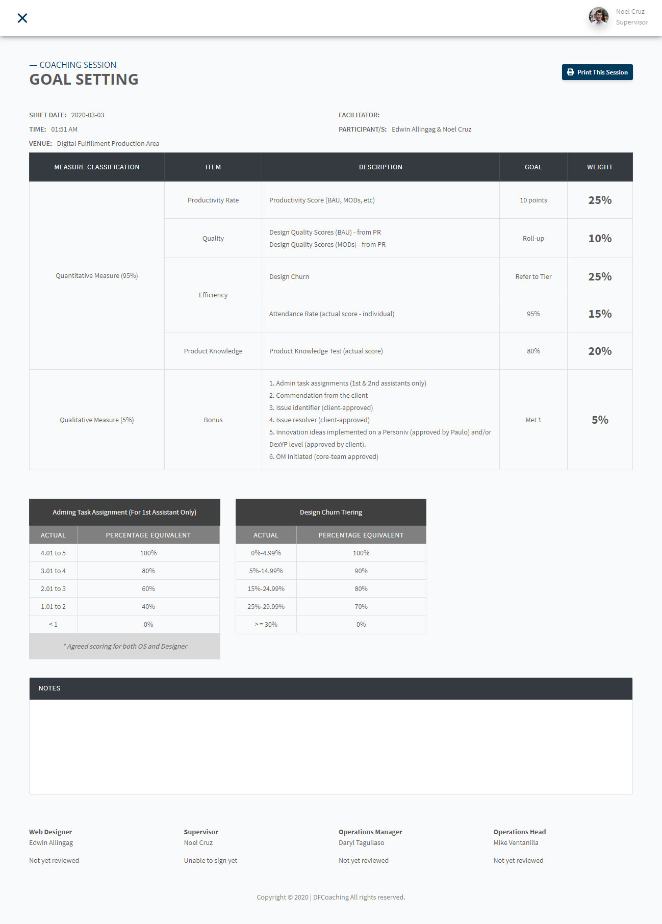
Components Sessions Goal Setting
Let the user view the next month scorecard details of selected agent
Scorecard table can dynamically change its format depending on the role of the agent
Has Notes field and four signatures to be signed by ticking the checkbox then verifying the signee’s password
(For agents only)

Slide 22
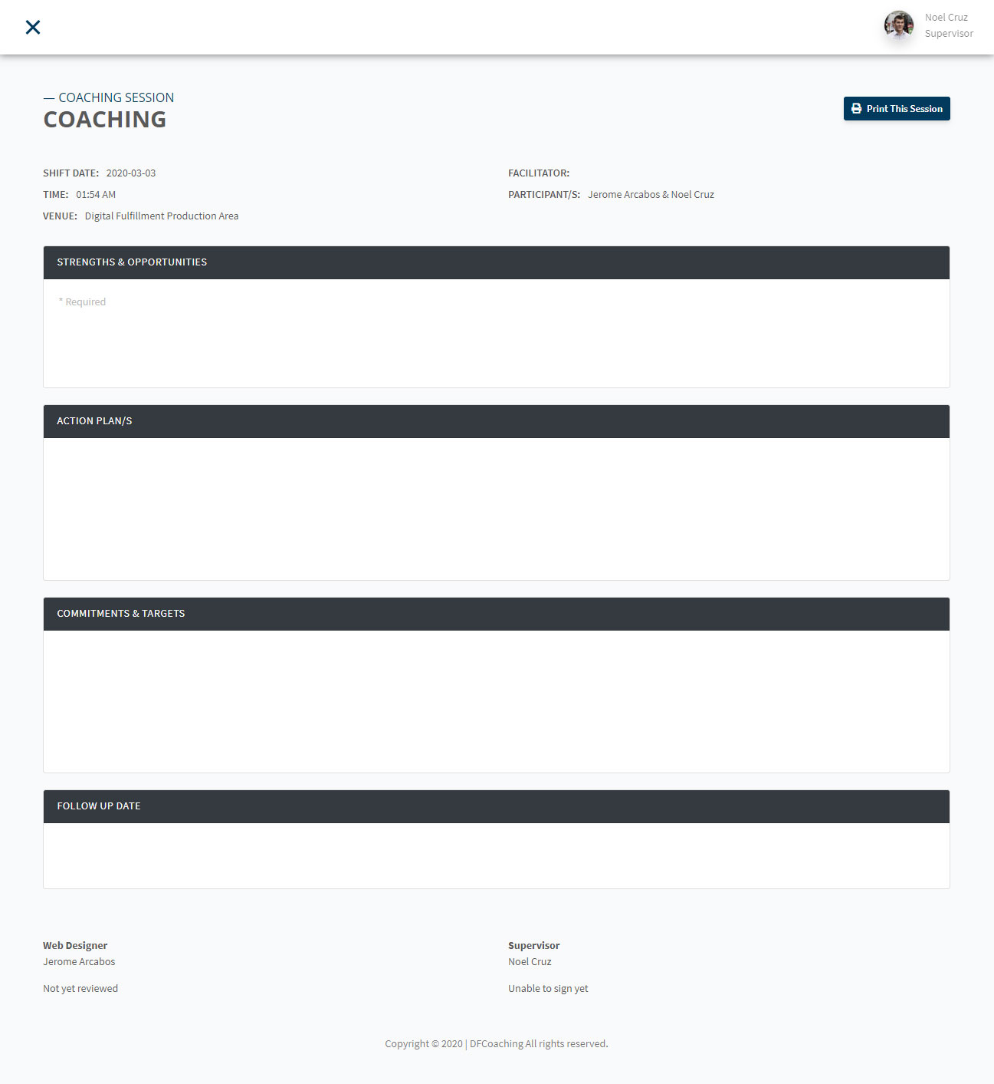
Components Sessions Coaching
Let the user view the coaching details of selected agent
Has Strength & Opportunities, Action Plan/s, Commitment & Targets and Follow up date fields and two signatures to be signed by ticking the checkbox then verifying the signee’s password
(For agents only)

Slide 23
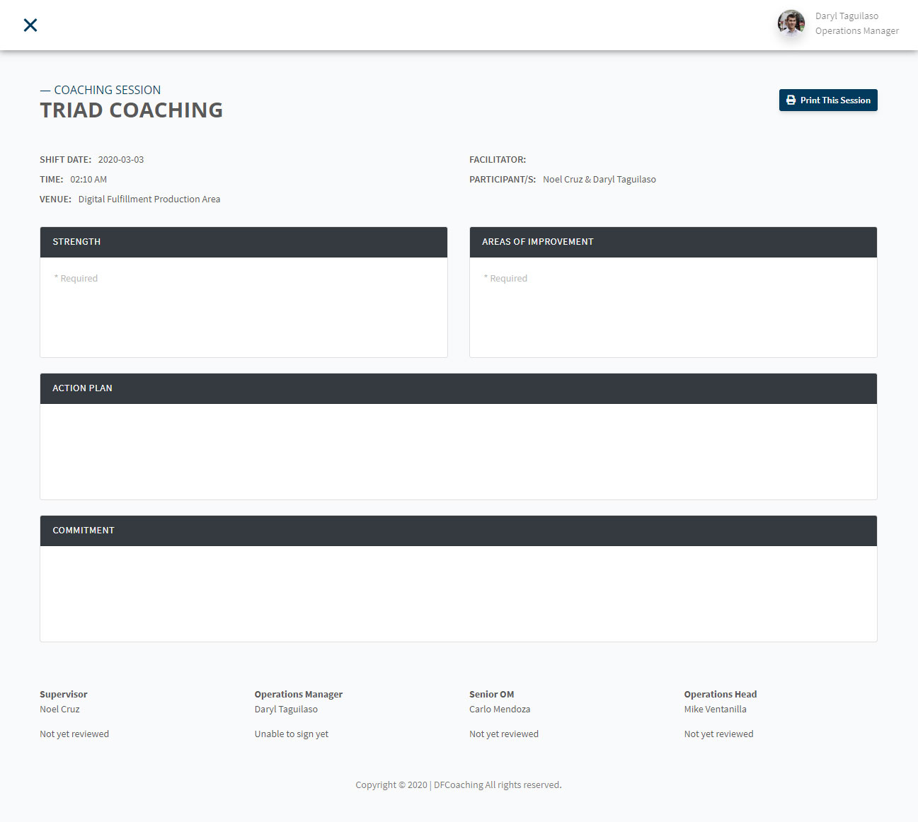
Components Sessions Triad
Let the user view the triad coaching details of selected supervisor
Has Strength, Areas of Improvement, Action Plan and Commitment fields and four signatures to be signed by ticking the checkbox then verifying the signee’s password
(For supervisors only)

Slide 24
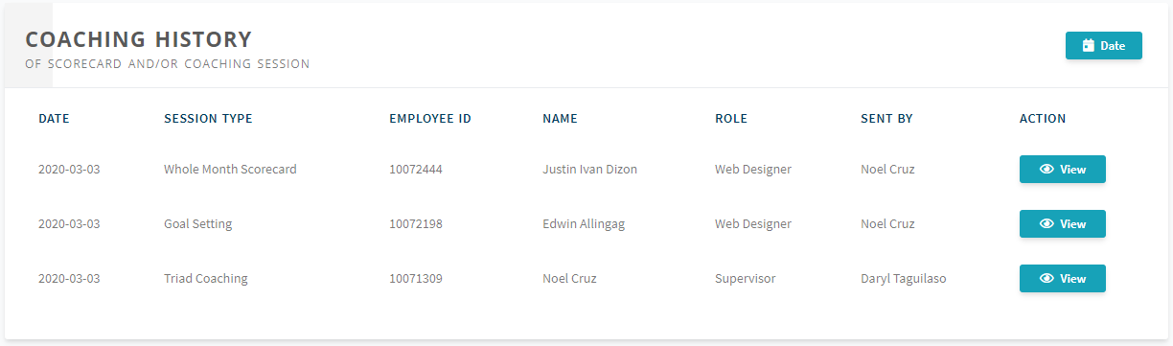
Components Sessions History
Let the user view all of the related sessions by the date range specified
Let the user review any session on the list

Slide 25
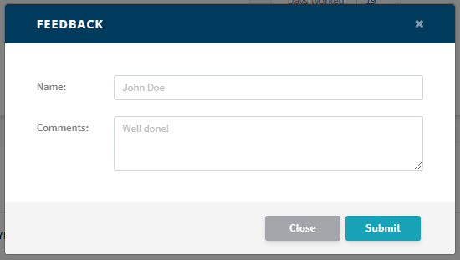
Components Sessions Feedback Form
Let the user submit any concern, suggestion or report any discovered software bugs to the developers

Slide 26
Thank you!
A web application for coaching and scorecard process automation

